Slide 1



Sentiment Analysis on Amazon food Reviews

Slide 2
TEAM MEMBERS
Gitik Kaushik (C0867079)
Harcharan Singh (C0863764)
Yajur Sethi (C0863424)
Tega Orido (C0857045)
Anargha Manoj (C0865188)

Slide 3
OBJECTIVES
Analyze Amazon food reviews using rule-based and machine learning-based methods.
Compare results from VADER and RoBERTa.
Visualize sentiment distributions and review score relationships.

Slide 4
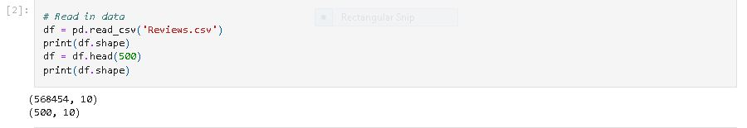
Data Loading and Exploration
We start by loading the dataset (Reviews.csv) using the Pandas library and explore its structure to understand the available attributes.

Slide 5
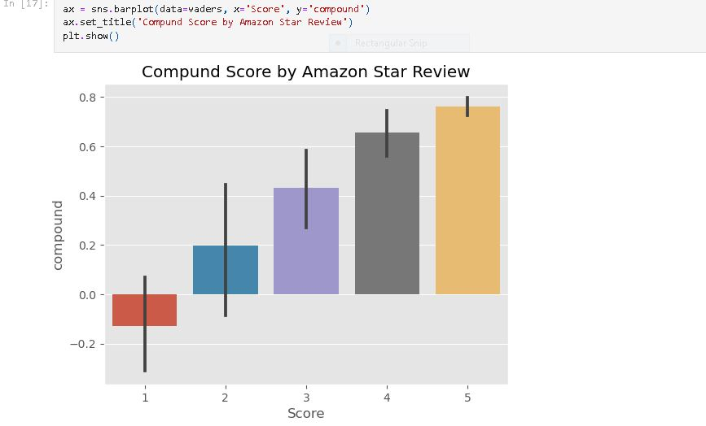
Data Preprocessing and Exploratory Data Analysis (EDA):
We preprocess the data by selecting a subset of the dataset for analysis. Additionally, we handle any missing or irrelevant data.

Slide 6

Natural Language Processing (NLP) with NLTK
We demonstrate basic NLP techniques such as tokenization and part-of-speech tagging using NLTK.

Slide 7
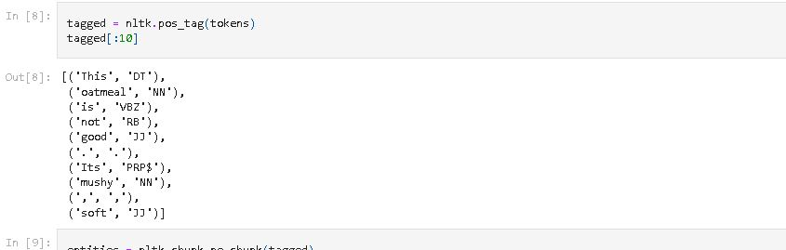
Natural Language Processing (NLP) with NLTK

Slide 8
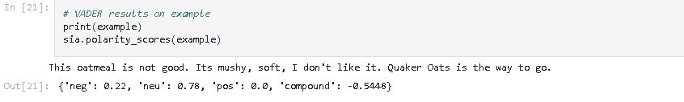
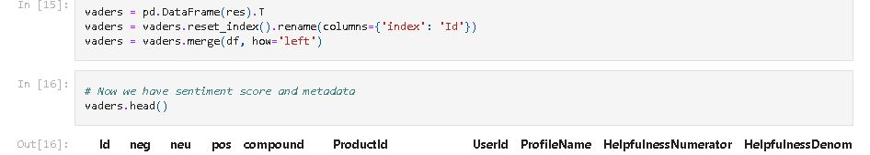
Sentiment Analysis with VADER
We utilize VADER, a rule-based sentiment analysis tool from NLTK, to calculate sentiment scores for each review.

Slide 9
Sentiment Analysis with RoBERTa:
We employ a pre-trained RoBERTa model from Hugging Face's Transformers library for machine learning-based sentiment analysis.
Load RoBERTa model and tokenizer
MODEL = "cardiffnlp/twitter-roberta-base-sentiment"
tokenizer = AutoTokenizer.from_pretrained(MODEL)
model = TFAutoModelForSequenceClassification.from_pretrained(MODEL)

Slide 10
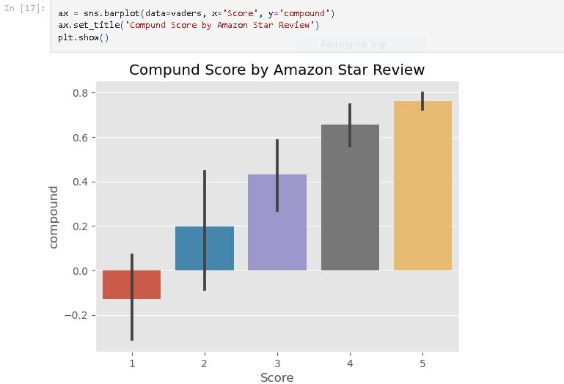
Data Visualization
Visualize relationships between sentiment scores and review scores using pair plots.

Slide 11
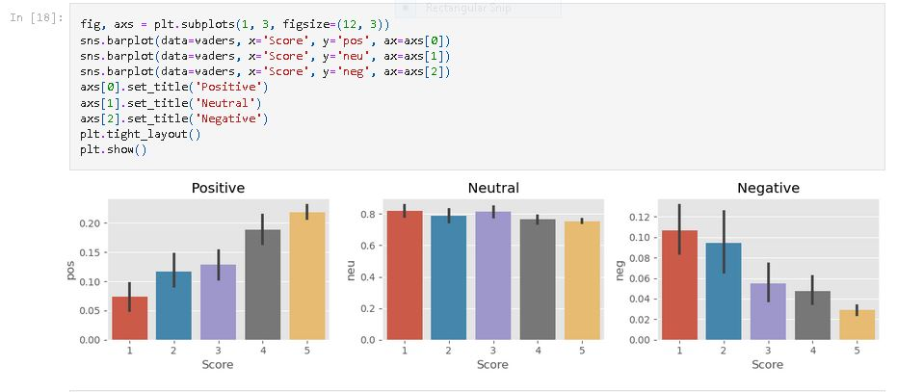
Data Visualization

Slide 12
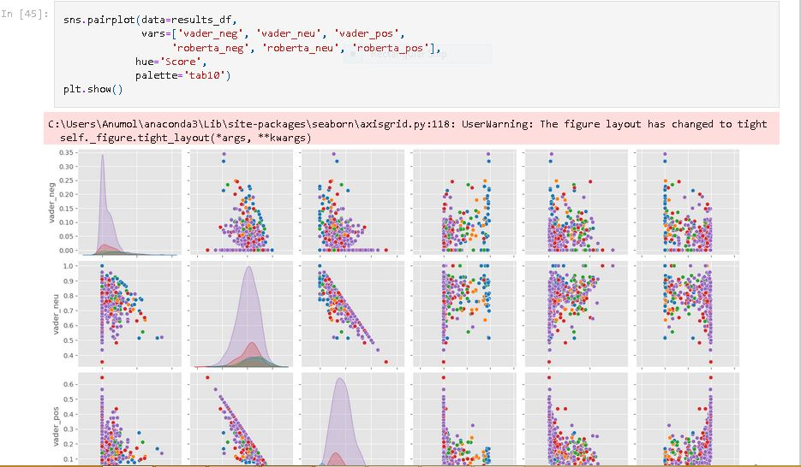
Data Visualization

Slide 13
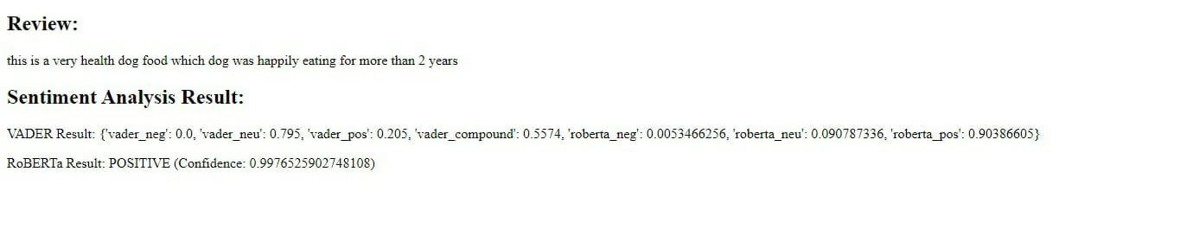
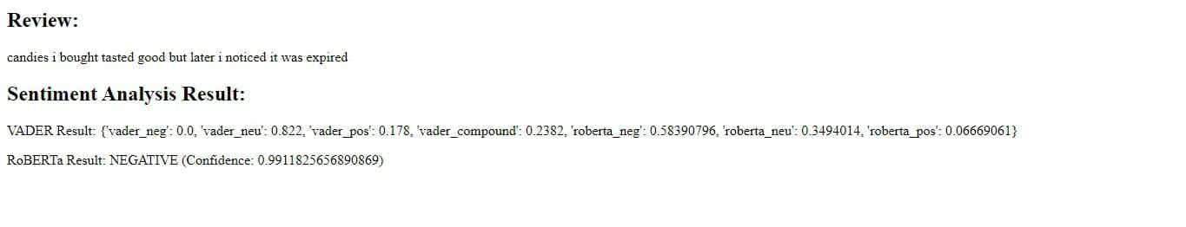
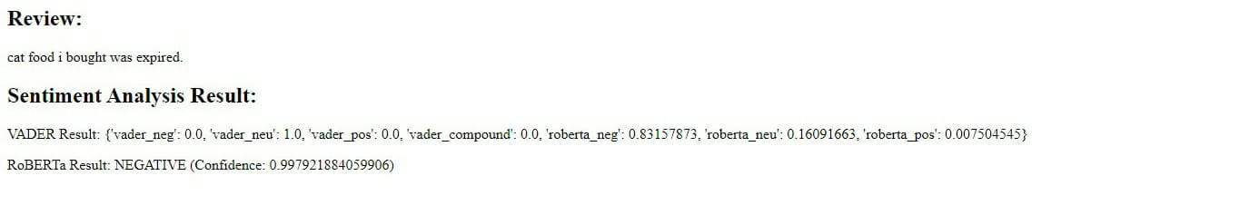
SENTIMENT ANALYSIS RESULT

Slide 14
CONCLUSION
This project provides a comprehensive analysis of sentiment in Amazon food reviews using both rule-based (VADER) and machine learning-based (RoBERTa) approaches. The comparison between these methods offers valuable insights. Visualizations enhance the understanding of sentiment distributions and their relationships with review scores.

Slide 15
THANK YOU

